Slide 1
Umbraco
April 2023
umBristol - @umBristol

Slide 2
Welcome to our
online event!
Agenda:
Welcome and the latest news on all things Umbraco.
"Catching the Umbraco Spark - a Front-End Developer's Takeaways from the Innovation Conference" by Louie Richardson
"Performance and Availability Improvements of Umbraco V10+ Websites with Hangfire Jobs" by Nurhak Kaya

Slide 3
Latest News

Slide 4

Umbraco security patches for 8, 10 and 11
Multiple medium-severity security issues were identified in March.
Umbraco released security patches for v8, v10 and v11 to address these issues.
Versions affected: Umbraco 8.2+ (8.2.0-8.18.6, 10.0.0-10.4.1 and 11.0.0-11.2.1)
No patches for v9 as the End of Life was Dec 2022 for v9.
V7 websites are not affected.

Slide 5
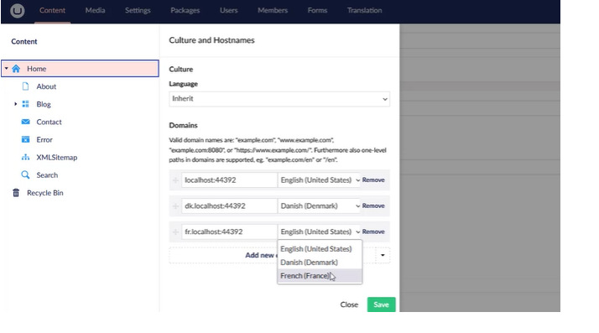
Umbraco 11.3.0
It was released this month.
Running on .NET 7 – not LTS.
57 features and improvements.
New UX and features for managing Culture and Hostnames in the backoffice.
It is possible to sort the domains now by dragging, dropping and saving the changes.

Slide 6
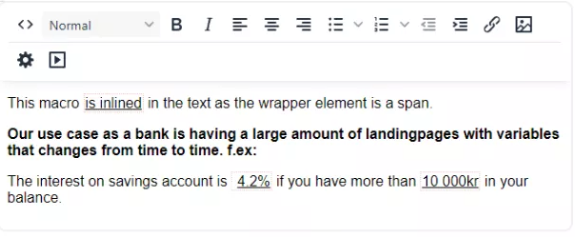
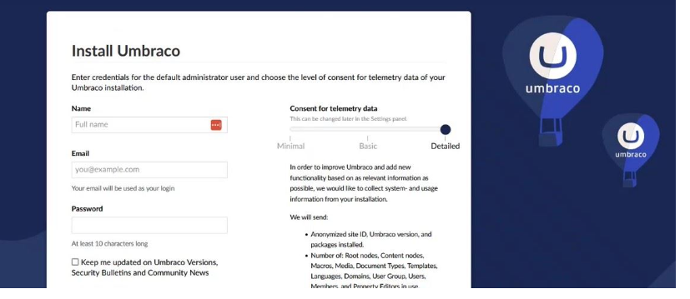
Umbraco 11.3.0 and 10.5.0
Inline Macros for 11.3.0
When using Macros in a RTE, it is now possible to add them inline.
V10.5.0 has been released.
Detailed telemetry by default
The default setting for telemetry has been changed to Detailed instead of Basic.
This will lead to more installations reporting and more details about how Umbraco CMS is being used.

Slide 7
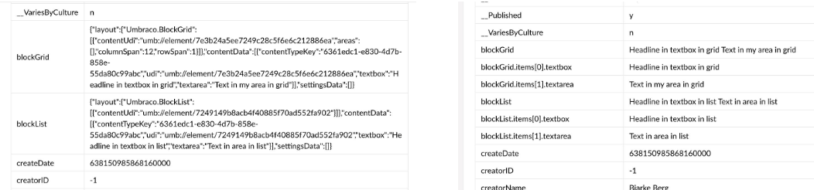
Umbraco 11.3.0 and 10.5.0
Improved indexing of complex Data Types, which should result in a better search experience.
Following Property Editors have been affected.
Block Grid
Block List
Tags
Media Picker
Image Cropper
The content will no longer be indexed as JSON but separate fields as is common for the rest of the Property Editors.

Slide 8
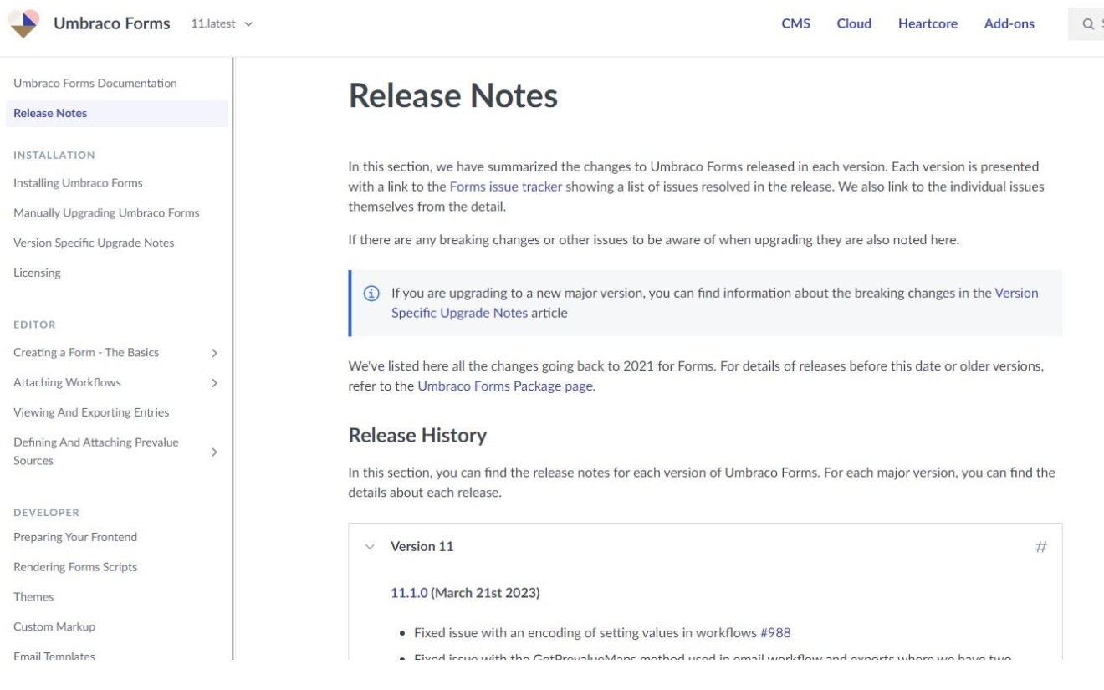
Umbraco product updates
https://docs.umbraco.com/ to be used to find the release notes for both Umbraco Forms and Deploy.
Umbraco Forms 11.1 and 10.3 are out.
Umbraco Workflow 11.1 and 10.1 are out, too!
New release of the Algolia integration for Umbraco CMS with a content indexing component based on the IDataEditor.PropertyIndexValueFactory property from Umbraco CMS.

Slide 9
Umbraco product updates
The Cookiebot integration is available on Umbraco Marketplace.
A small package providing the ability to load Cookiebot Banner and Declaration scripts into Umbraco sites.

Slide 10

Umbraco acquires Outfield Digital
Umbraco has acquired Outfield Digital, along with Vendr and Konstrukt.
Matt and Lucy Brailsford are now part of the Umbraco HQ Team.
Umbraco is working on how to integrate Vendr and Konstrukt into their commercial offering and they hope to make Vendr available as an Umbraco product sometime later in 2023.
Umbraco will contact the existing Vendr and Konstrukt clients directly about any changes.

Slide 11
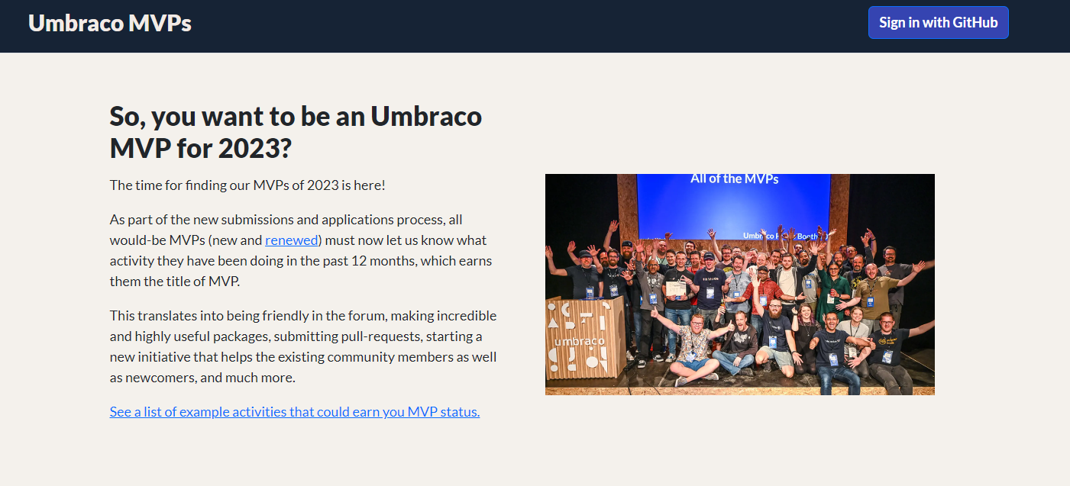
Umbraco MVP submissions
Submissions will remain open until May 1st, 2023.
Sign in with your GitHub account, add your activities and submit your application form.
For details: https://mvp.umbraco.com/

Slide 12


Slide 13
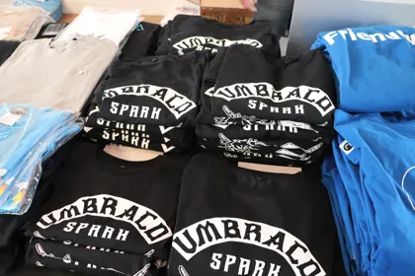

Talks
The new backoffice
Playmaker: Dances with Wolves
Umbraco anywhere
Content recommendations
Sustainability focus
Ultimate upgrade guide from v7/8 to v11
Advanced debugging
GitHub actions

Slide 14
Upcoming Events

Slide 15
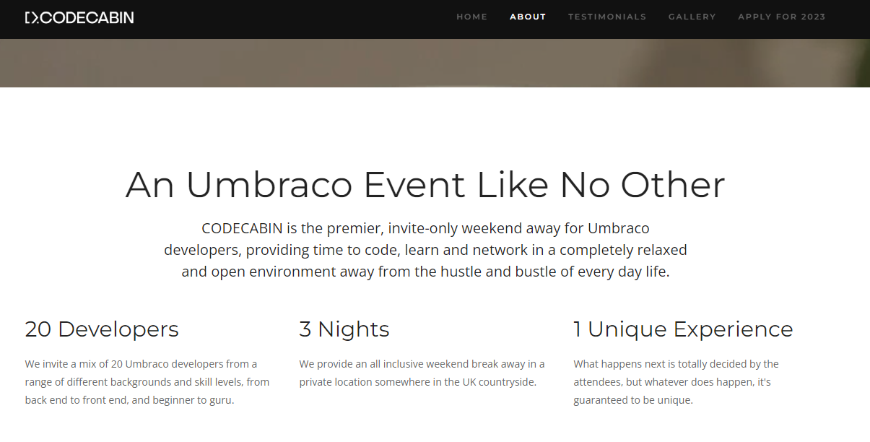
CODECABIN23
The sixth CODECABIN (an Umbraco unconference) takes place on Fri 8th - Mon 11th Sep 2023.
Application deadline: Fri 7th Jul 2023.
Ticket price is £375 (if successful).
20 attendees only.
Organised by community members: Matt & Lucy Brailsford, Lee Kelleher, Lotte Pitcher and Karl Tynan
For details: https://codecab.in/
Apply now!

Slide 16

Umbraco Codegarden – 14h – 16th June, 2023
Early bird tickets are available until April 21.
Umbraco Awards 2023 submissions ended on April 14.
For details: https://codegarden.umbraco.com/

